Slide 1

The Case for Non-linguistic Approach to Teaching Engineering Thinking
Leon Brânzan, dept. of Informatics and System Engineering, Faculty of Computers, Informatics and Microelectronics, Technical University of Moldova
leon.brinzan@iis.utm.md, https://fcim.utm.md/

Slide 2
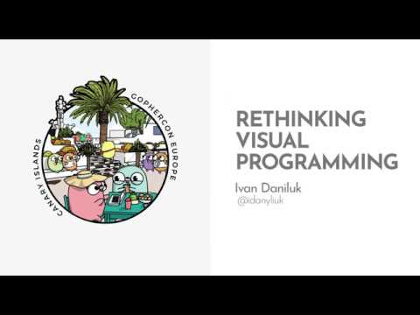
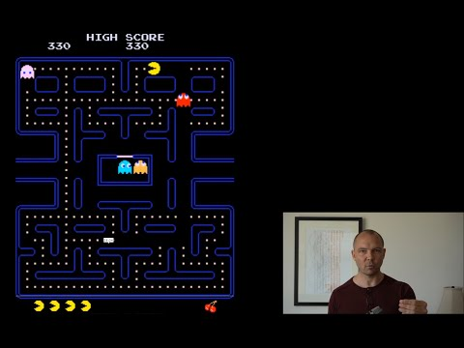
"Rethinking Visual Programming"
Ivan Daniluk
"Video Games and the Future of Education"
Jonathan Blow

Slide 3
Why learning to program software is hard
And teaching to program - twice as hard
Verbal/textual transfer of knowledge doesn't suit complex topics well
Programming languages lack uniformity, each requiring a different strategy to learn and master
Students have not developed intuition that could be relied upon to boost the learning process

Slide 4
Problems with verbal transfer of knowledge
And using text for education in general
Knowledge needs to be deconstructed by the teacher before it can be reconstructed by students, this process lacks feedback
Cognitive load tends to increase dramatically, impairing students' ability to memorize content
The intention that others understand one's intentions is inherently uncertain
Text's primary function is to preserve knowledge, not educate

Slide 5
Problems with learning programming languages
They rely on mathematical notation too much
Expression1 = Expression2

Slide 6
Problems with learning programming languages
They rely on mathematical notation too much
Expression1 = Expression2
x = a * (b + c) + d

Slide 7
Problems with learning programming languages
They rely on mathematical notation too much
Expression1 = Expression2
x = a * (b + c) + d
mov edx, DWORD PTR [rbp-24]
mov eax, DWORD PTR [rbp-28]
add eax, edx
imul eax, DWORD PTR [rbp-20]
mov edx, eax
mov eax, DWORD PTR [rbp-32]
add eax, edx
mov DWORD PTR [rbp-4], eax

Slide 8
Problems with learning programming languages
Each of them is special in its own way
x = j if a > b else k

Slide 9
Problems with learning programming languages
Each of them is special in its own way
x = j if a > b else k
x = a > b -> j, k

Slide 10
Problems with learning programming languages
Each of them is special in its own way
x = j if a > b else k
x = a > b -> j, k
int x = (a > b) ? j : k;

Slide 11
What we could do to solve it
Hint: "non-linguistic" is the keyword
Limit use of text in favor of multimedia instructions (cognitive theory of multimedia learning)
Use special tools that provide instant feedback, improve inference, promote reflection
Use language-agnostic forms of developing the right kind of intuition
Develop engineering thinking early by introducing programming concepts before teaching a programming language

Slide 12
*insert demonstration here*

Slide 13
This talk was not about:
Gamification of education
Using video games in education
Video games transforming education
This talk was about:
Reconsidering the traditional approach to teaching
Recognizing the power of non-linguistic communication
Using advances in software development to improve how we teach

Slide 14

Links and references available at:
https://bit.ly/case-for-non-linguistic-teaching

